Slide 1
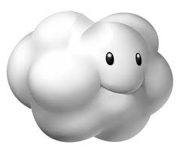
Cloud Computing is a Nebulous Subject
Or how I learned to love VDF on Amazon

Slide 2
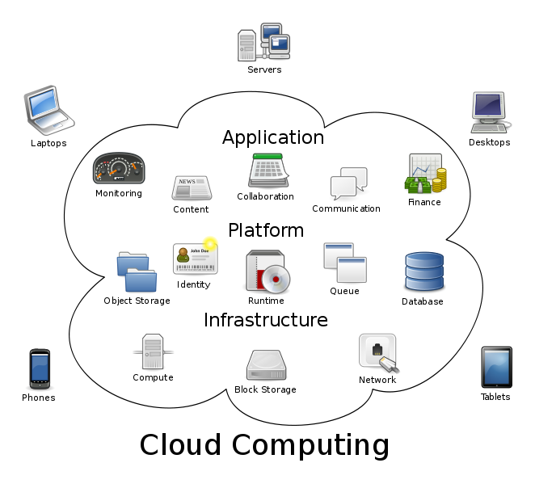
What is Cloud Computing

Slide 3
WikiPedia
Computing clouds provide computation, software, data access, and storage resources without requiring cloud users to know the location and other details of the computing infrastructure. Within limits, cloud users can consume any amount of these resources without having first to acquire servers or other computing equipment. A parallel to this concept can be drawn with the electricity grid, wherein end-users consume power without needing to understand the component devices or infrastructure required to provide the service.
End users access cloud based applications through a web browser or a light weight desktop or mobile app while the business software and data are stored on servers at a remote location. Cloud application providers strive to give the same or better service and performance as if the software programs were installed locally on end-user computers. In some cases, legacy applications (line of business applications that until now have been prevalent in thin client Windows computing) are delivered via a screen-sharing technology, while the computing resources are consolidated at a remote data centre location; in other cases, entire business applications have been coded using web-based technologies such as AJAX.
http://en.wikipedia.org/wiki/Cloud_computing

Slide 4
Cloud Providers You Have Probably Heard of:
Amazon EC2 Cloud Computing has a proprietary license with a 8.50¢ per hour base price. It guarantees 99.95% uptime and 1.7GB RAM, 160GB local storage, 1 EC2 Compute Unit.
Google App Engine Cloud Computing has a proprietary license with a 0¢ per hour base price. It guarantees 99.9% uptime and The first 500 MB of persistent storage are free and comes with enough CPU and bandwidth for about 5 million page views a month..

Slide 5
Cloud Providers cont.
Microsoft Windows Azure Cloud Computing has a proprietary license with a 12¢ per hour base price. It guarantees 99.9% uptime and 1.6 GHz CPU, 1.75 GB RAM, 225 GB Instance Storage, Moderate I/O Performance.

Slide 6
Important Features for VDF
Microsoft Server 2003-2008 platform
SQL Database support
Amazon
Microsoft SQL Server and other SQL platforms supported (MySQL, Oracle, Postgress, DB2)
Native Dataflex
Azure
Microsoft SQL Server preferred
Others above supported via VM Role

Slide 7
Security
Physical Security
Amazon: infrastructure is housed in Amazon-controlled data centers throughout the world. Only those within Amazon who have a legitimate business need to have such information know the actual location of these data centers, and the data centers themselves are secured with a variety of physical controls to prevent unauthorized access.
Azure: Physical security of the data centers (locks, cameras, biometric devices, card readers, alarms)
Firewalls, application gateways and IDS to protect the network
Access Control Lists (ACLs) applied to virtual local area networks (VLANs) and applications
Authentication and authorization of persons or processes that request access to data
Hardening of the servers and operating system instances
Redundant internal and external DNS infrastructure with restricted write access
Securing of virtual machine objects
Securing of static and dynamic storage containers

Slide 8
Costs
Free Tier ( 1 year)
750 hours of Amazon EC2 Microsoft Windows Server Micro Instance usage (613 MB of memory and 32-bit and 64-bit platform support) – enough hours to run continuously each month*
750 hours of an Elastic Load Balancer plus 15 GB data processing*
30 GB of Amazon Elastic Block Storage, plus 2 million I/Os and 1 GB of snapshot storage*
5 GB of Amazon S3 standard storage, 20,000 Get Requests, and 2,000 Put Requests*
100 MB of storage, 5 units of write capacity, and 10 units of read capacity for Amazon DynamoDB.**
15 GB of bandwidth out aggregated across all AWS services*
25 Amazon SimpleDB Machine Hours and 1 GB of Storage**
100,000 Requests of Amazon Simple Queue Service**
100,000 Requests, 100,000 HTTP notifications and 1,000 email notifications for Amazon Simple Notification Service**
10 Amazon Cloudwatch metrics, 10 alarms, and 1,000,000 API requests**

Slide 9
Amazon VPC
Amazon Virtual Private Cloud enables you to create a virtual network topology—including subnets and routing—for your Amazon Elastic Compute Cloud (EC2) resources.
Amazon EC2 instances you launch are randomly assigned a public IP address in the Amazon EC2 address space. Amazon VPC enables you to create an isolated portion of the Amazon Web Services (AWS) cloud—a VPC—and launch Amazon EC2 instances that have private (RFC 1918) addresses in the range of your choice (e.g., 10.0.0.0/16). You can define subnets within your VPC that enable you to group similar kinds of instances based on IP address range.
You can attach different types of gateways to your VPC to enable communication with the Internet or with your home network (over an IPsec VPN tunnel). You can set up routing and security to control the flow of traffic in and out of the instances and subnets.

Slide 10
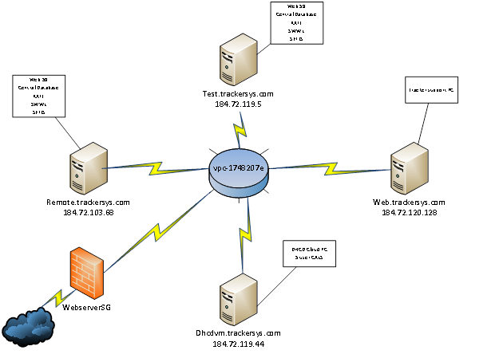
VPC at Tracker

Slide 11
Let’s see what it looks like
Now we will login and see what it looks like…
Amazon Console Management

