Slide 1
Real World Dynamic AI Integration with Visual DataFlex Applications
Showing the methods and results of integrating Dynamic AI with a Visual DataFlex application.
Bob Cergol
bob.cergol@dataaccess.com
Notes:
SPEAKER INTRODUCTION & BACKGROUN / WHAT THIS PRESENTATION IS ABOUT / WHAT YOU WILL SEE: MORE SHOW, LESS TELL….

Slide 2
What is Dynamic AI?
Platform for rapid development and delivery of business intelligence
Is to BI what VDF is to database Apps.
Ad-hoc query, reporting & analysis tool
Uses any SQL-aware data source (…VDP)
100% browser based [“hot” Excel, email links…]
Interactive graphs & custom style sheets
Scheduled delivery of tailored intelligence
Notes:
WHAT YOU CAN DO WITH IT / WHAT YOU USE IT FOR / UNIQUE CHARACTERISTICS

Slide 3
A VDF / Dynamic AI Success Story
Comprehensive DF/VDF Mfg. Mgt. System
“Mgt.” capabilities grossly under-utilized
Mission: leverage latent intelligence to maximize value of I.T. asset to the business
Programming headache: mobile managers living in email, internet, iPad … fast results!
Eureka! moment in 2009 … beaming BI …
Then…integration VDF, Solomon, Pageflex, SageCRM, BI for our major customers

Slide 4
Why integrate with VDF applications?
The most rapid, productive reporting solution – period …
… when content & interactivity trumps pixel position & section-specific logic needs
Unique capabilities adds value to app.
Integrate content from disparate systems
New business opportunities with your clients – “BI” is a huge growth market.
Notes:
REAL WORLD EXPERIENCE / REAL WORLD RESULTS

Slide 5
Reporting Solutions Comparison
Winprint: wielding a stylus to stream free-form data/info to X,Y coordinates
Crystal / VRW: cutting and placing stencils through which to pour structured data to create data/info patterns in precise sections
Dynamic AI: invoking an aggregation engine that serves up hierarchical, isolated, linked layers of information for dynamic presentation w/automatic positioning
Notes:
DIFFERENT TOOLS ARE OPTIMIZED FOR DIFFERENT REQUIREMENTS

Slide 6
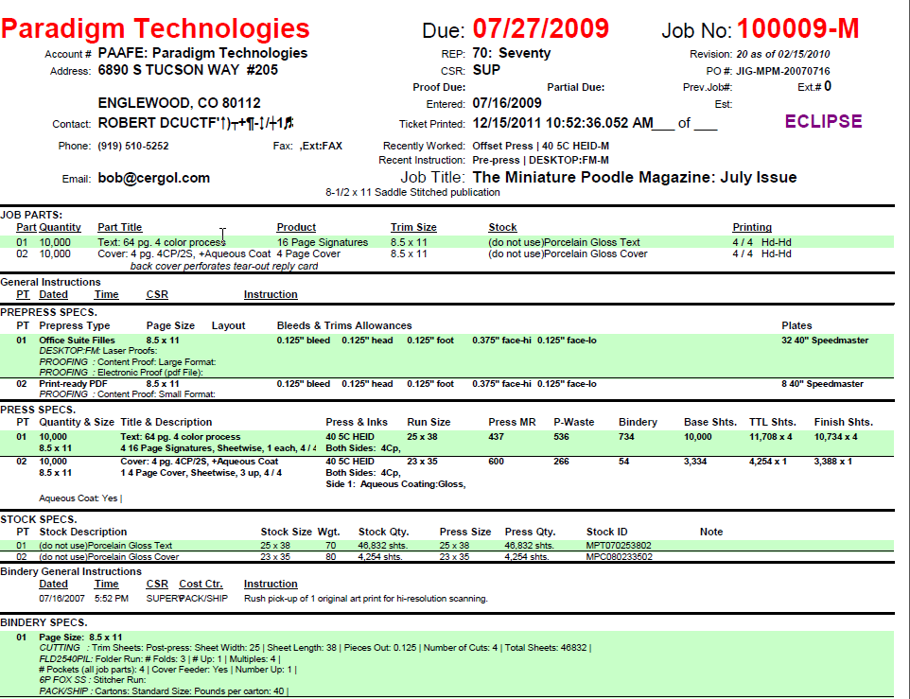
I need a stylus or airbrush to do this:

Slide 7
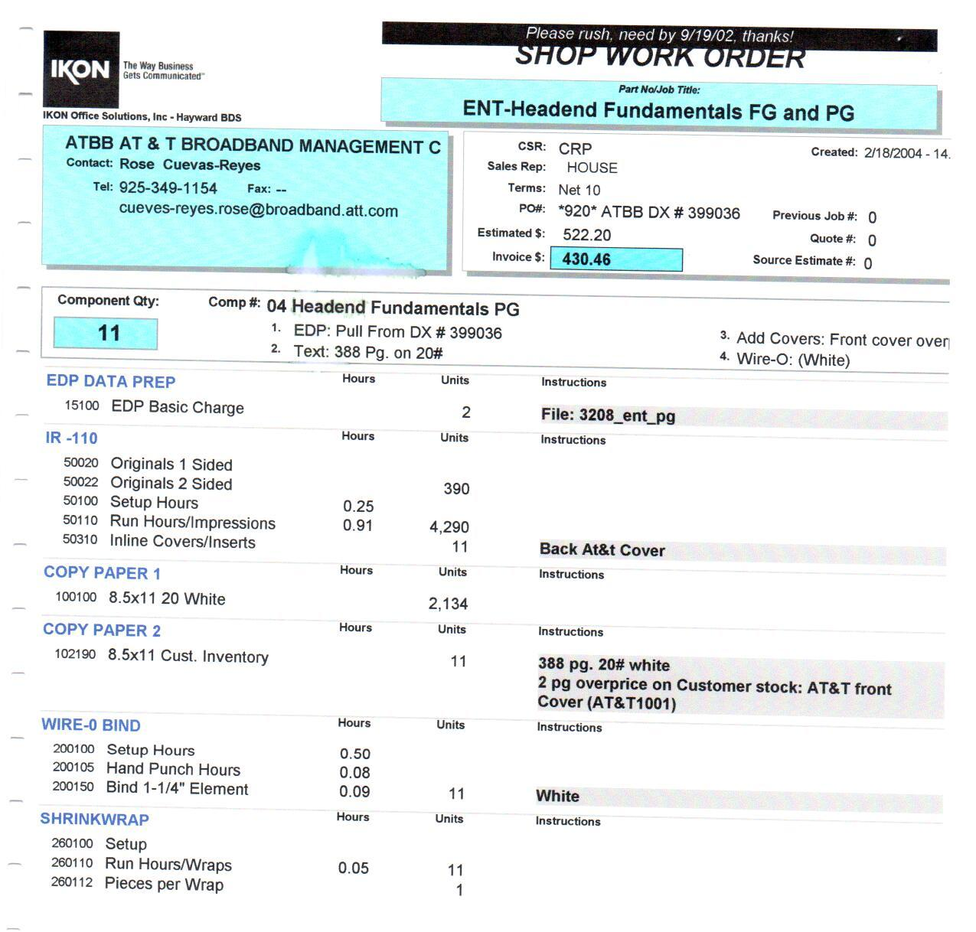

Slide 8
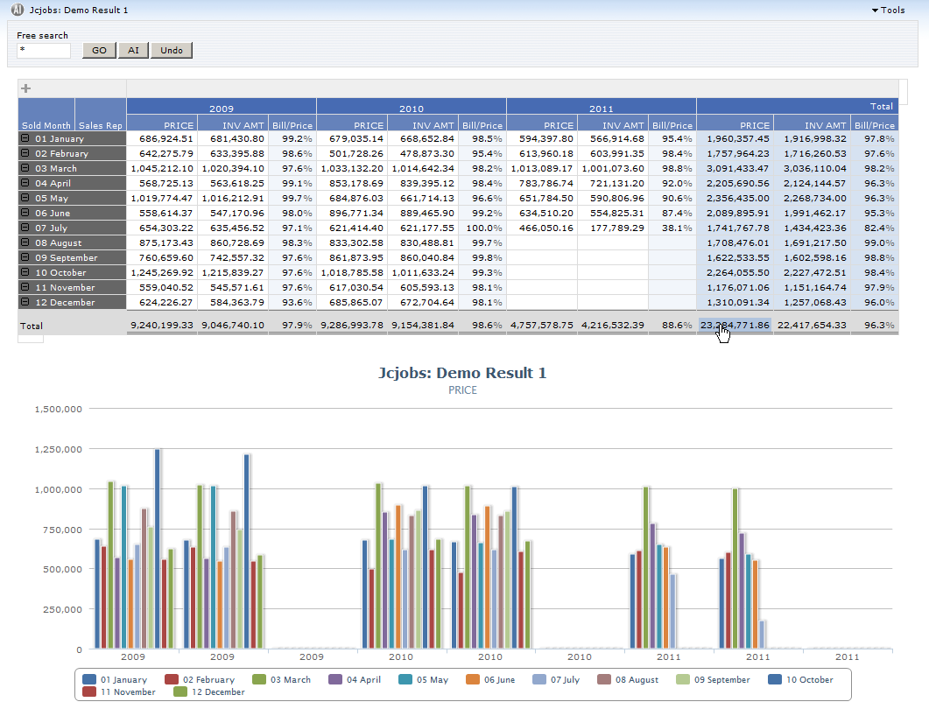

Slide 9
Unique capabilities adds value to app.
“Filters & Free Search” powerful, extensive, enforced
Ad-hoc Design accessible to app. users
Drill-Down, and down, and down … to other rpts.
Interactive charting and customizable graphs
Fast Performance – server-side querying
Analytics/KPI’s delivered from your App
Report is decoupled from compiled app.
Export / Integration (Excel, Word, etc.)
Editing – if enabled, interesting possibilities…
Completes your suite of reporting tools
Notes:
ABOVE AND BEYOND SATISFYING A GIVEN INFORMATION REQUIREMENT YOU GET ALL THIS FUNCTIONALITY

Slide 10
Example to prove productivity claim….
Problem: boss wants intelligence showing top 10 customers by $volume, by yr/mo, by product, for given sales rep for selected year(s), showing sales in each level as % of total – with graph – and – a yr/yr comparison by month, customer, product. – in 15 minutes?
Solution: Use Dynamic AI to generate the intelligence and integrate into boss’ VDF application
Notes:
DRAG-AND-DROP REPORT DESIGN / VDF SOURCE CHANGES, COMPILE APPLICATION, DEMO END-RESULT

Slide 11
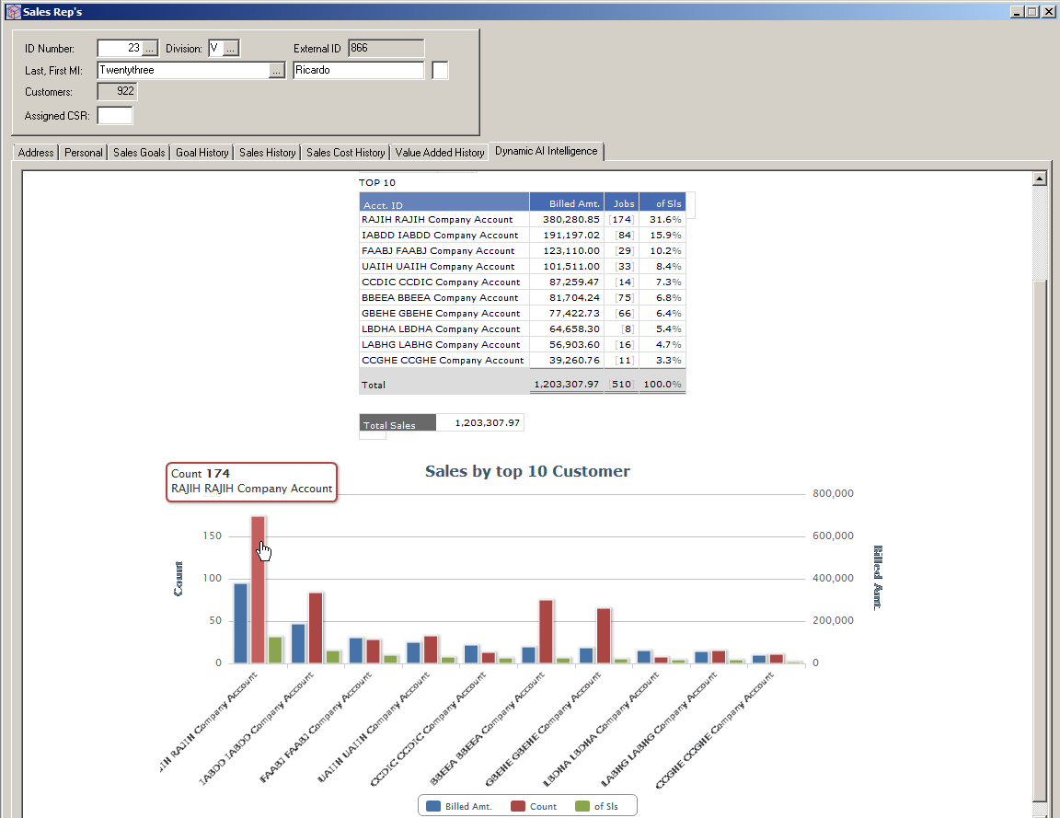

Slide 12
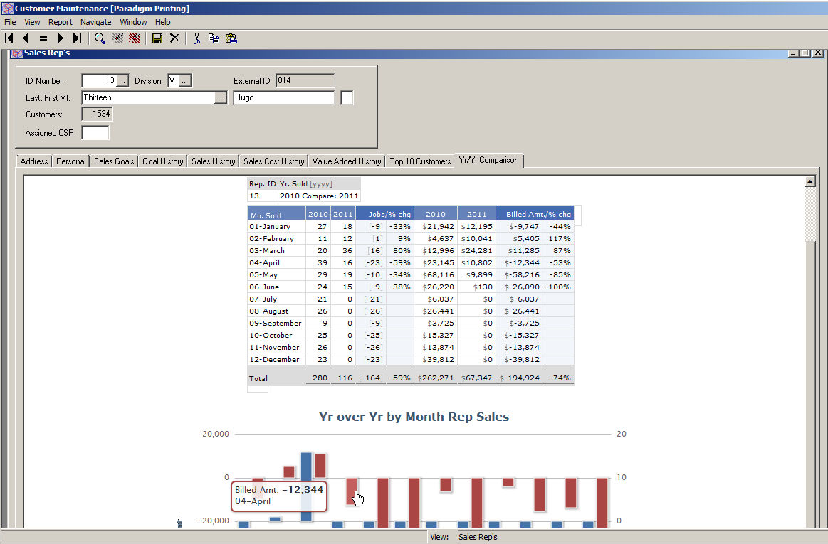

Slide 13
Examples: Leverage existing content
Bringing intelligence to the operations staff level
Work-in-process examples
Job Cost examples
Purchase orders, receipts
Shipments
Invoicing: waiting to bill
Integrate with existing branded web sites

Slide 14
Disparate system content integration:
Example 1: data transfer
automate “push or pull” extraction of data
import data to create orders in VDF mfg. production system
Example 2: information integration
VDF mfg. system invoicing application
Foreign accounting system A/R aging

Slide 15
Specialized Examples:
Using Codemast for Alias Bundle to drive enforced filtered content
Using Codemast to map programmed reports to deployed reports
Combining simple but effective editing with delivery of intelligence: Invoice approval; AR Aging / collections notes

Slide 16
VDF Integration Classes
From DAE: Ronald Zwiers & Eddy Kleinjan
cDynamicAIReport.pkg
cDynamicAICrypter.pkg
cDynamicAICryptographer.pkg
cIEFrame.pkg
Email bob.cergol@dataaccess.com to obtain
Alternatively: generate your own URL
Launches report in default browser
Requirements: Dynamic AI server & SQL data source [take a look at Visual Data Pump]

Slide 17
Next Steps
obtain free Dynamic AI server evaluation
Contact: fern-b@dataaccess.com or bob.cergol@dataaccess.com
Connect to SQL data source
Select a table and click the “AI” button
Open a resulting report and review its design
Talk to growing number of other VDF developers who have discovered Dynamic AI!

